Slide 1
CSS Multiple Backgrounds
Week 07- Student Presentation
Adam Checketts

Slide 2
Review points for multiple background images
Background
Color
Image
Position
Repeating
IMPORTANT- remember order of images
Coding: Long Hand vs Short Hand
EXPERIMENT!

Slide 3
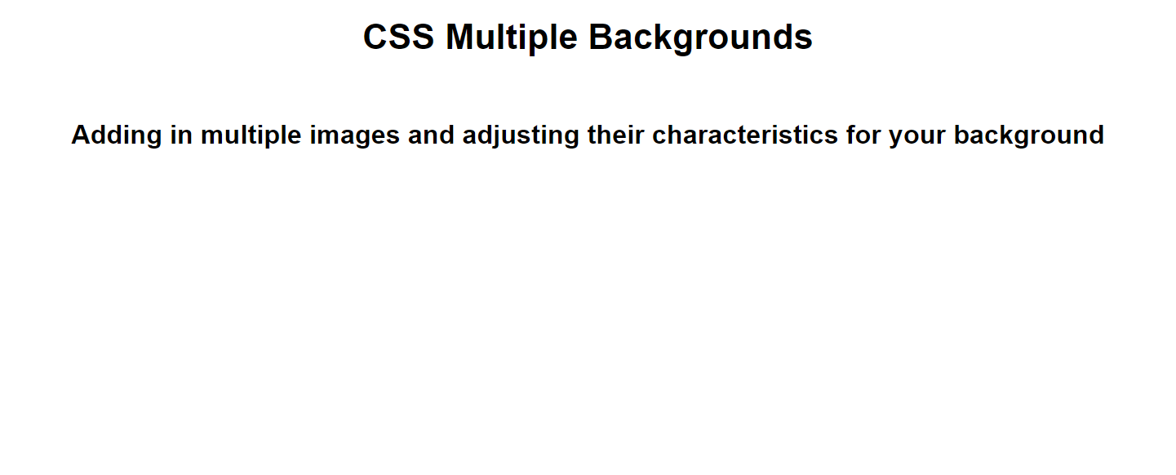
Basic webpage

Slide 4
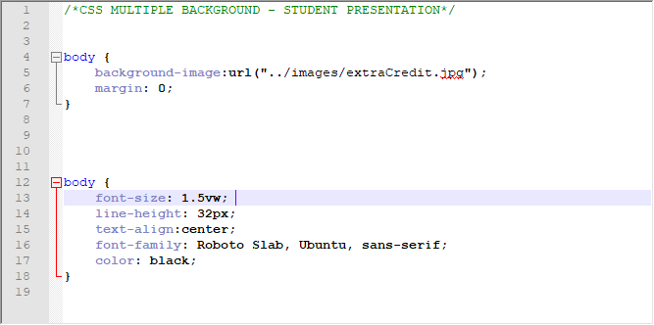
Adding in background image

Slide 5

Background Image- extra credit

Slide 6

Background Image- not quite

Slide 7

Background Image- careful of repeating images

Slide 8

Background Image- better

Slide 9

Background Image

Slide 10
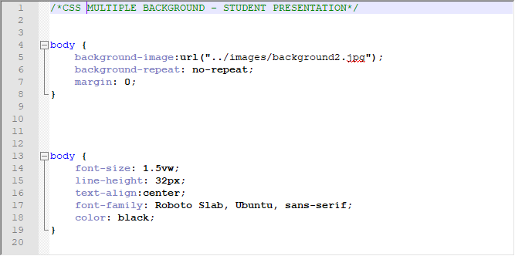
Background Image- no repeat

Slide 11
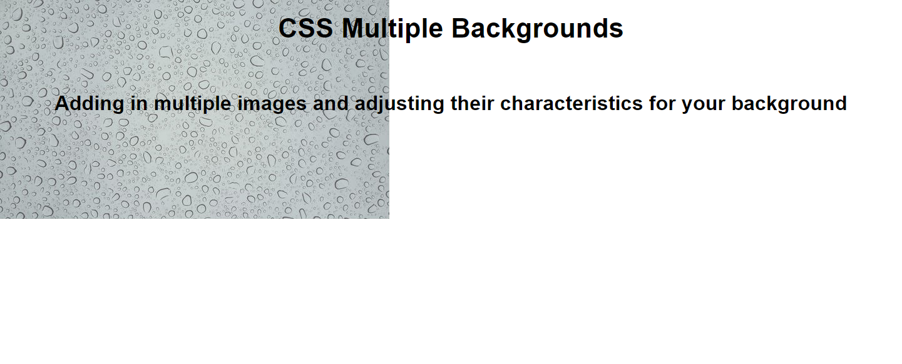
Background Image- no repeat

Slide 12
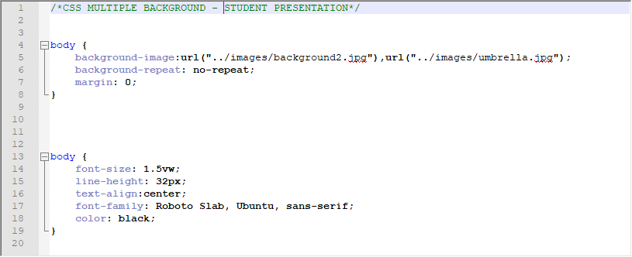
Background Image- adding 2nd image

Slide 13
Background Image- where is the 2nd image?

Slide 14
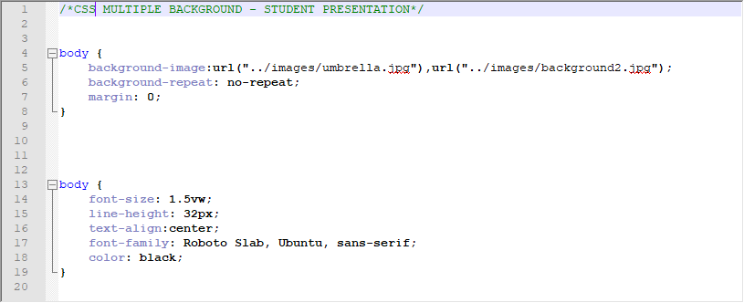
Background Image- the order of the images is VERY important

Slide 15
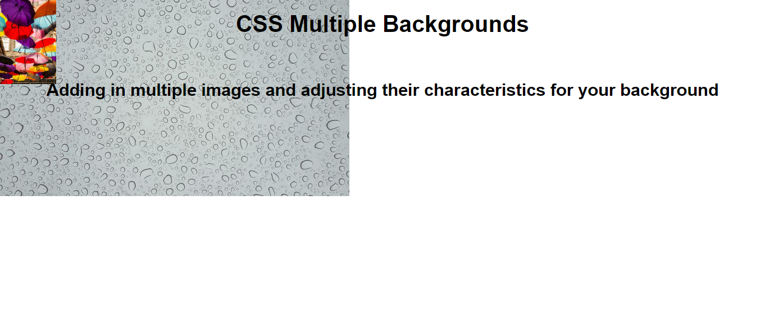
Background Image- notice how the images are now overlaying each other

Slide 16
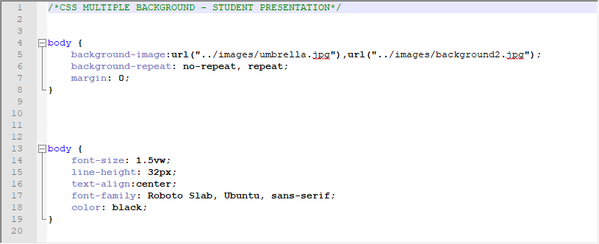
Background Image- repeat vs no-repeat

Slide 17
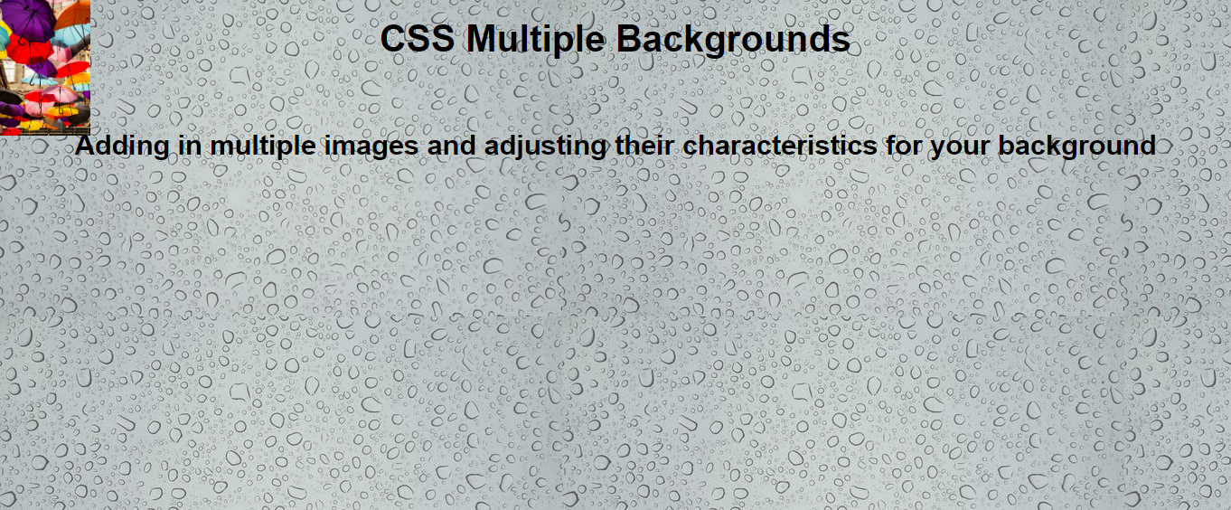
Background Image- repeat vs no-repeat

Slide 18
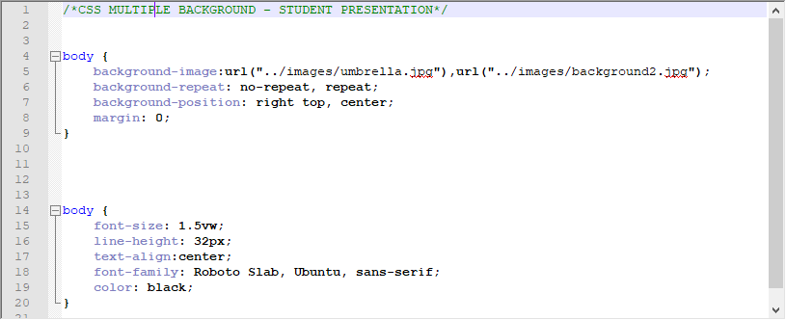
Background Image- positions

Slide 19
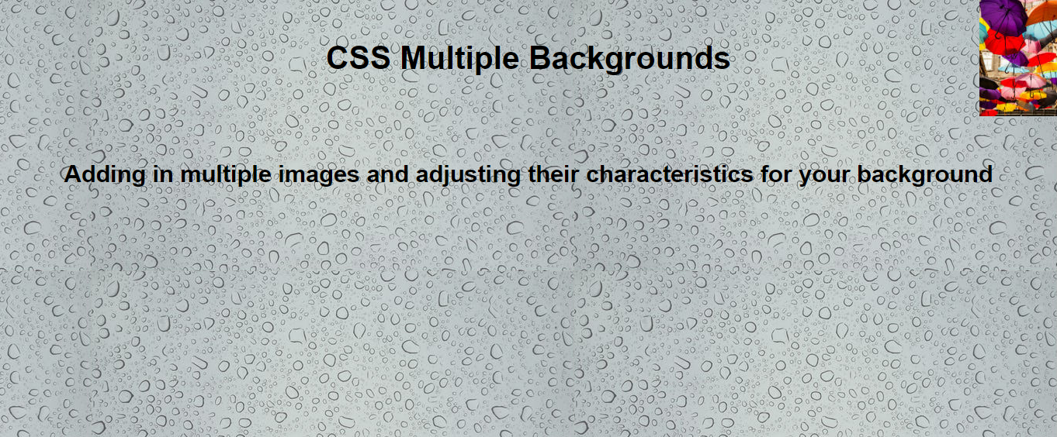
Background Image- positions

Slide 20
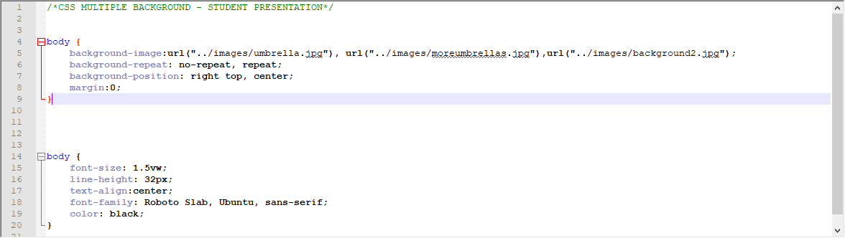
Background Image- adding a 3rd image

Slide 21

Background Image- adding a 3rd image

Slide 22
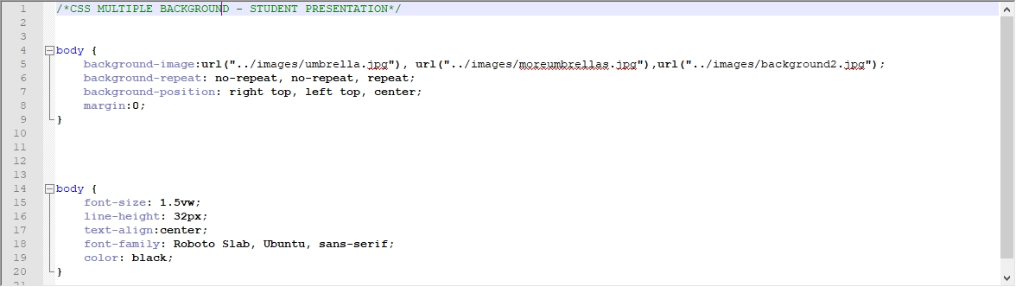
Background Image- remember to properly align the attributes of each image

Slide 23
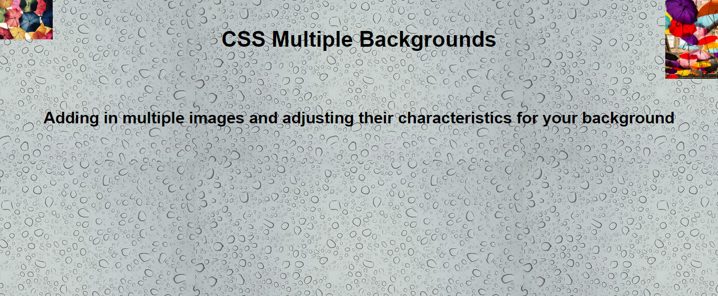
Background Image- remember to properly align the attributes of each image

Slide 24
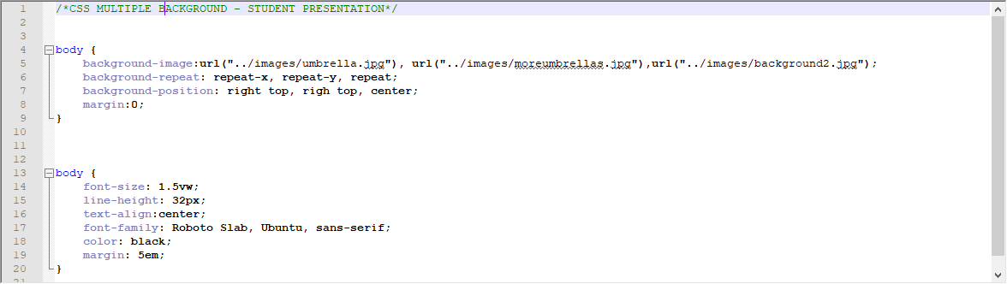
Background Image- different options for repeating pattern

Slide 25
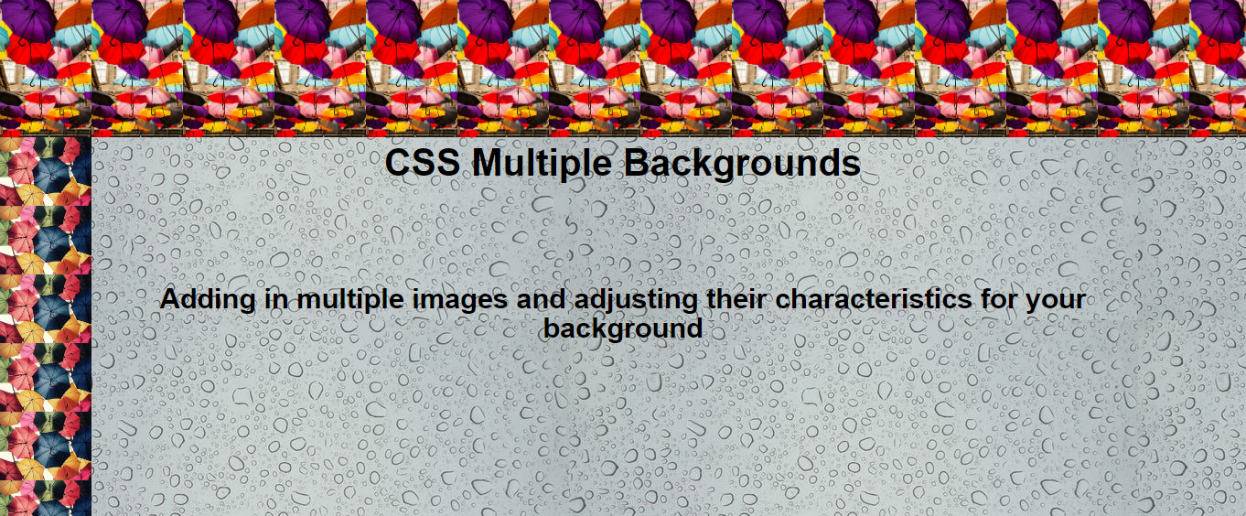
Background Image- different options for repeating pattern

Slide 26
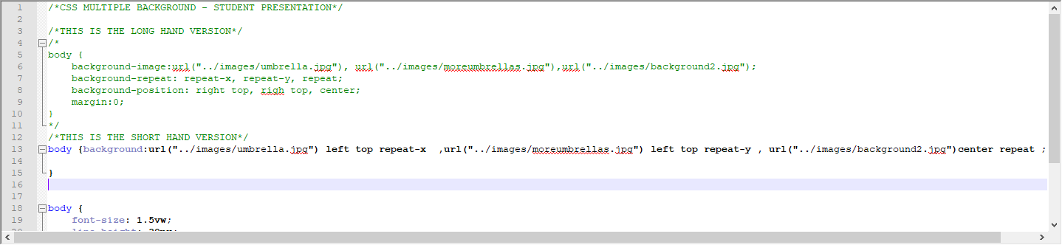
Background Image- long hand vs short hand

Slide 27
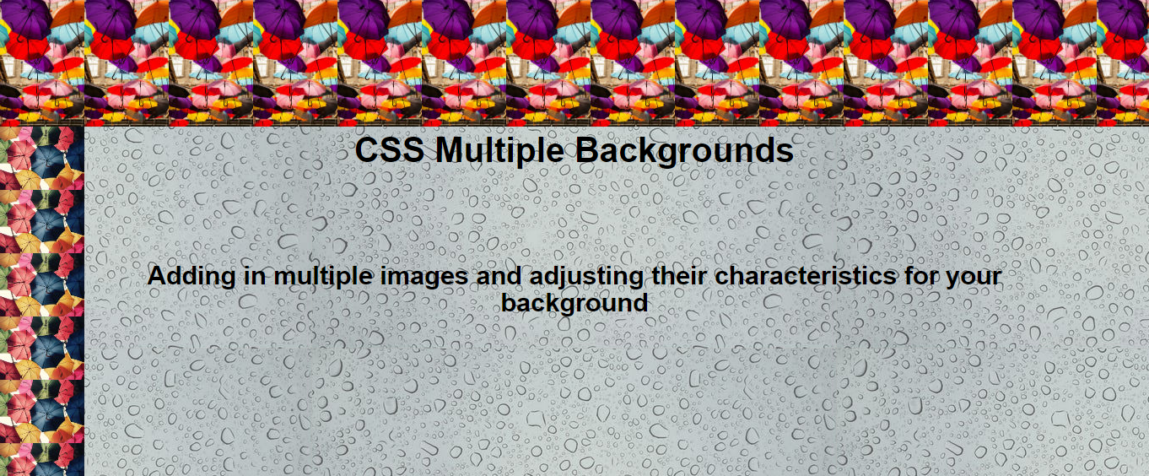
Background Image- long hand vs short hand no visible difference

Slide 28
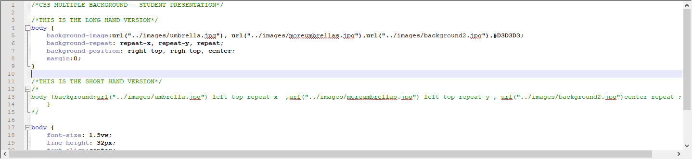
Background Image- recommended to add back up color just in case image(s) fail to load

Slide 29
Review what we learned for today
Background
Color
Image
Position
Repeating
IMPORTANT- remember order of images
Coding: Long Hand vs Short Hand
EXPERIMENT!

Slide 30
Sources
Webpages:
YouTube videos:
W3 Schools
https://www.w3schools.com/css/css3_backgrounds.asp
Background Images
https://www.w3schools.com/css/css3_backgrounds.asp
Multiple background images
https://www.youtube.com/watch?v=D1JgW_bVq-4
Header background
https://www.youtube.com/watch?v=mA_htWfLLQs

